Slide 1
ENGR-AD-113 Digital Logic
Instructor: Yi Fang (yfang@nyu.edu)
Office: C-156
Phone: 026284891
TA: Muhammad Faraz Sheikh (faraz.afazl@nyu.edu)
Chapter 1 <number>

Slide 2
Announcement
Lecture session on Tuesday moved to Thursday Lab session?
Lab sessions will be firstly described by TA or instructor and be completed individually at home.
Chapter 1 <number>

Slide 3

Welcome Digital World!
https://www.tumblr.com/
Chapter 1 <number>

Slide 4
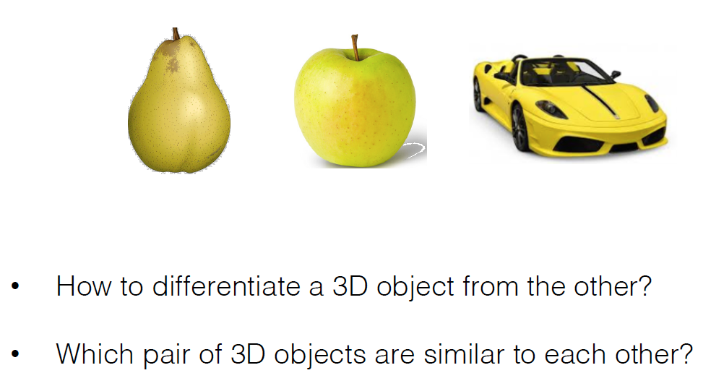
3D Computer Vision Example
Chapter 1 <number>

Slide 5
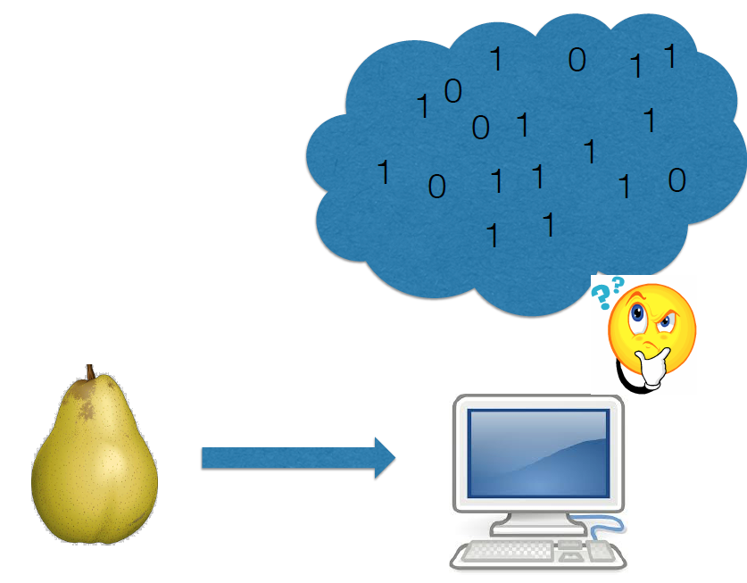
Digital representation of 3D Object
Chapter 1 <number>

Slide 6
Component 1:
Introduction and Overview
Digital Systems and Computer Systems
Number Systems [binary, decimal, octal and hexadecimal] and base conversion
Arithmetic Operations
Introduction to Coding Theory
Chapter 1 <number>

Slide 7
Component 1:
Introduction and Overview
Digital Systems and Computer Systems
Number Systems [binary, decimal, octal and hexadecimal] and base conversion
Introduction to Coding Theory
Arithmetic Operations
Chapter 1 <number>

Slide 8
Digital System
Takes a set of discrete information inputs and discrete internal information (system state) and generates a set of discrete information outputs.
Discrete
Discrete
Inputs
Information
Discrete
Processing
Outputs
System
Examples:
Human brain
Candy machine
System State
Chapter 1 <number>

Slide 9
Types of Digital Systems
No state present
  Combinational Logic System
  Output = Function(Input)
State present
  State updated at discrete times
  => Synchronous Sequential System
  State updated at any time
  =>Asynchronous Sequential System
  State = Function (State, Input)
  Output = Function (State)
  or Function (State, Input)
Chapter 1 <number>

Slide 10
Digital System Example:
A Digital Counter (e. g., odometer):
Count Up
0
0
1
3
5
6
4
Reset
Inputs:
Count Up, Reset
Outputs:
Visual Display
State:
"Value" of stored digits
Chapter 1 <number>

Slide 11
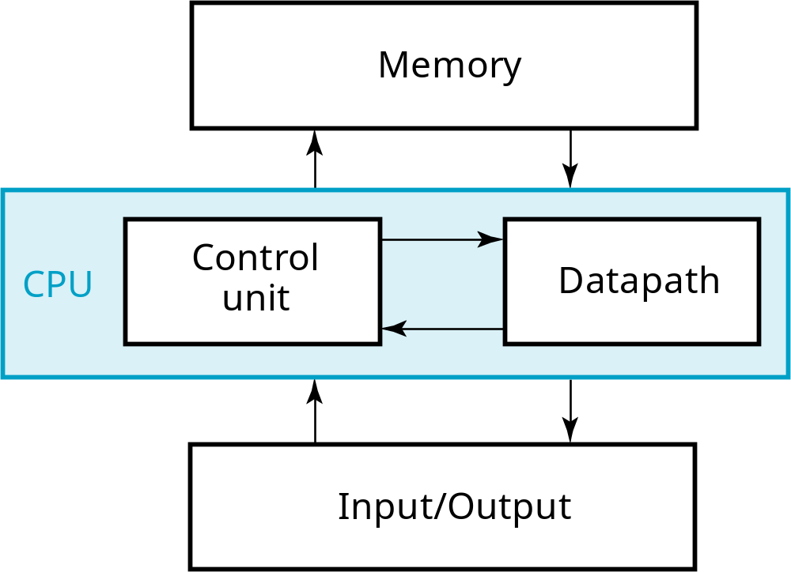
A Digital Computer Example
Inputs: Keyboard, mouse, modem, microphone
Outputs: CRT, LCD, modem, speakers
Chapter 1 <number>
Notes:
Answer: Part of specification for a PC is in MHz. What does that imply? A clock which defines the discrete times for update of state for a synchronous system. Not all of the computer may be synchronous, however.

Slide 12
Signal
An information variable represented by physical quantity.
For digital systems, the variable takes on discrete values.
Two level, or binary values are the most prevalent values in digital systems.
Binary values are represented abstractly by:
  digits 0 and 1
  words (symbols) False (F) and True (T)
  words (symbols) Low (L) and High (H)
  and words On and Off.
Binary values are represented by values or ranges of values of physical quantities
Chapter 1 <number>

Slide 13
Signal Examples Over Time
Time
Continuous in value & time
Analog
Digital
Discrete in value & continuous in time
Asynchronous
Synchronous
Discrete in value & time
Chapter 1 <number>

Slide 14
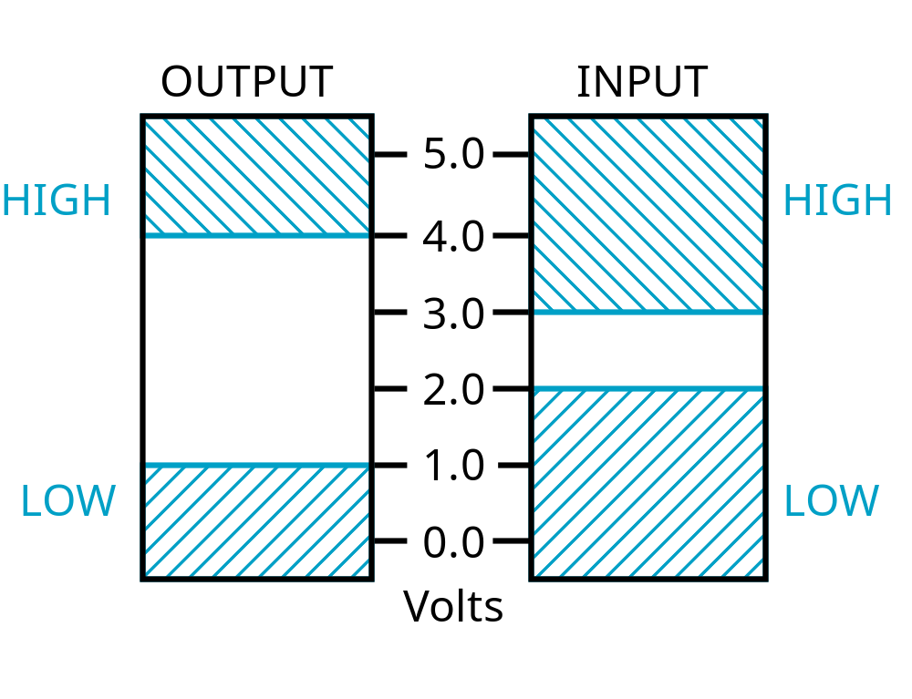
Signal Example – Physical Quantity: Voltage
Threshold Region
Chapter 1 <number>
Notes:
The HIGH range typically corresponds to binary 1 and LOW range to binary 0. The threshold region is a range of voltages
for which the input voltage value cannot be interpreted reliably as either a 0 or a 1.

Slide 15
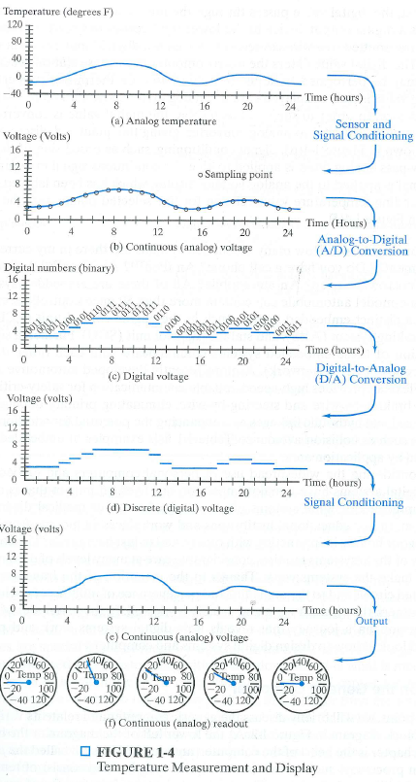
Example: Temperature Measurement and Display
Chapter 1 <number>

Slide 16
Information unit: bit and byte
A binary digit is called a bit.
Information is represented in digital computers by groups of bits.
8 bits in a byte
Chapter 1 <number>

Slide 17
Special unit: K, M, G
2¹⁰ (1024) is Kilo, denoted "K"
2²⁰ (1,048,576) is Mega, denoted "M"
2³⁰ (1,073, 741,824)is Giga, denoted "G"
Chapter 1 <number>

Slide 18
Example: Calculate the memory space
The exact number of bits in a memory
  10G bytes = 10*1,073, 741,824 * 8 bits
Chapter 1 <number>

Slide 19
Component 1:
Introduction and Overview
Digital Systems and Computer Systems
Number Systems [binary, decimal, octal and hexadecimal] and base conversion
Introduction to Coding Theory
Arithmetic Operations
Chapter 1 <number>

Slide 20
Number Systems – Representation
Positive radix, positional number systems
A number with radix r is represented by a string of digits:
A_{n - 1}A_{n - 2} … A₁A₀ . A₋ ₁ A₋ ₂ … A_{- m + 1} A_{- m}
in which 0 ≤ A_{i} < r and . is the radix point.
The string of digits represents the power series:
(
)
(
)
i = n - 1
j = - 1
(Number)_{r}
=
∑
i
+
∑
j
A
r
A
r
i
j
i = 0
j = - m
(Integer Portion)
(Fraction Portion)
+
Chapter 1 <number>

Slide 21
Number Systems – Examples
 | General | Decimal | Binary
Radix (Base) | r | 10 | 2
Digits | 0 => r - 1 | 0 => 9 | 0 => 1
0 1 2 3 Powers of 4 Radix 5 -1 -2 -3 -4 -5 | r⁰ r¹ r² r³ r⁴ r⁵ r ⁻¹ r ⁻² r ⁻³ r ⁻⁴ r ⁻⁵ | 1 10 100 1000 10,000 100,000 0.1 0.01 0.001 0.0001 0.00001 | 1 2 4 8 16 32 0.5 0.25 0.125 0.0625 0.03125
Chapter 1 <number>

Slide 22
Commonly Occurring Bases
Name
Radix
Digits
Binary
2
0,1
Octal
8
0,1,2,3,4,5,6,7
Decimal
10
0,1,2,3,4,5,6,7,8,9
Hexadecimal
16
0,1,2,3,4,5,6,7,8,9,A,B,C,D,E,F
The six letters (in addition to the 10
integers) in hexadecimal represent:
Chapter 1 <number>
Notes:
Answer: The six letters A, B, C, D, E, and F represent the digits for values
10, 11, 12, 13, 14, 15 (given in decimal), respectively, in hexadecimal.
Alternatively, a, b, c, d, e, f are used.

Slide 23
Special Powers of 2
2¹⁰ (1024) is Kilo, denoted "K"
2²⁰ (1,048,576) is Mega, denoted "M"
2³⁰ (1,073, 741,824)is Giga, denoted "G"
Chapter 1 <number>

Slide 24
Converting Binary to Decimal
To convert to decimal, use decimal arithmetic to form Σ (digit × respective power of 2).
Example:Convert 11010₂ to N₁₀:
Chapter 1 <number>
Notes:
Powers of 2: 43210
11010₂ =>
1 X 2⁴ = 16
+ 1 X 2³ = 8
+ 0 X 2² = 0
+ 1 X 2¹ = 2
+ 0 X 2⁰ = 0
26₁₀

Slide 25
Converting Decimal to Binary
Method 1
  Subtract the largest power of 2 (see slide 14) that gives a positive remainder and record the power.
  Repeat, subtracting from the prior remainder and recording the power, until the remainder is zero.
  Place 1’s in the positions in the binary result corresponding to the powers recorded; in all other positions place 0’s.
Example: Convert 625₁₀ to N₂
Chapter 1 <number>
Notes:
625 – 512 = 113 => 9
113 – 64 = 49 => 6
49 – 32 = 17 => 5
17 – 16 = 1 => 4
1 – 1 = 0 => 0
Placing 1’s in the result for the positions recorded and 0’s elsewhere,
9 8 7 6 5 4 3 2 1 0
1 0 0 1 1 1 0 0 0 1

Slide 26
Conversion Decimal to Binary
Method 2
To convert a decimal number to binary:
Repeatedly divide the decimal number by the 2 and save the remainders.
The digits of the binary number are the remainders in reverse order of their computation.
Example: Convert 625₁₀ to N₂
Chapter 1 <number>

Slide 27
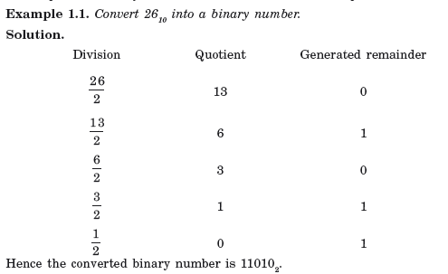
Example
Chapter 1 <number>

Slide 28
Conversion tips
Base r1 Decimal (base 10)
Base r2
Summation
of weights
Division operations
Example: Convert 53₇ to N₅
Chapter 1 <number>

Slide 29
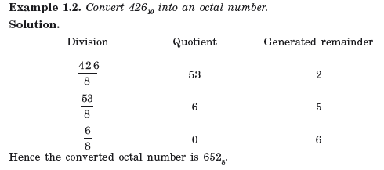
Example
Chapter 1 <number>

Slide 30
Conversion tips: Shortcut
Base r1 Decimal (base 10)
Base r2
Summation
of weights
Division operations
If r1 is a
power of r2,
or vice versa
Chapter 1 <number>

Slide 31
Octal (Hexadecimal) to Binary and Back
Octal (Hexadecimal) to Binary:
  Restate the octal (hexadecimal) as three (four) binary digits starting at the radix point.
Binary to Octal (Hexadecimal):
  Group the binary digits into three (four) bit groups starting at the radix point, padding with zeros as needed in the leftmost positions.
  Convert each group of three (four) bits to an octal (hexadecimal) digit.
Chapter 1 <number>

Slide 32
Octal to Hexadecimal via Binary
Convert octal to binary.
Use groups of four bits and convert as above to hexadecimal digits.
Example: Octal to Binary to Hexadecimal
6 3 5 7 ₈
Chapter 1 <number>
Notes:
Answer 1:
6 3 5 . 1 7 7 ₈
110|011|101 . 001|111|111 ₂
Regroup:
1|1001|1101 . 0011|1111|1(000)₂
Convert:
1 9 D . 3 F 8₁₆
Answer 2: Marking off in groups of three (four) bits corresponds to dividing or multiplying by 2³ = 8 (2⁴ = 16) in the binary system.

Slide 33
Numbers in Different Bases
Decimal
Binary
Octal
Hexa
decimal
(Base 10)
(Base 2)
(Base 8)
(Base 16)
00
00000
00
00
01
00001
01
01
02
00010
02
02
03
00011
03
03
04
00100
04
04
05
00101
05
05
06
00110
06
06
07
00111
07
07
08
01000
10
08
09
01001
11
09
10
01010
12
0A
11
0101
1
13
0B
12
01100
14
0C
13
01101
15
0D
14
01110
16
0E
15
01111
17
0F
16
10000
20
10
Chapter 1 <number>

Slide 34
Component 1:
Introduction and Overview
Digital Systems and Computer Systems
Number Systems [binary, decimal, octal and hexadecimal] and base conversion
Introduction to Coding Theory
Arithmetic Operations
Chapter 1 <number>

Slide 35
Non-numeric Binary Codes
Given n binary digits (called bits), a binary code is a mapping from a set of represented elements to a subset of the 2^{n} binary numbers.
Example: A
binary code
for the seven
colors of the
rainbow
Code 100 is
not used
Color
Binary Number
Red
000
Orange
001
Yellow
010
Green
011
Blue
101
Indigo
110
Violet
111
Chapter 1 <number>

Slide 36
Number of Bits Required
Given M elements to be represented by a binary code, the minimum number of bits, n, needed, satisfies the following relationships:
    2^{n} ≥ M > 2^{(n – 1)}
    n = ⎡log₂ M⎤
Example: How many bits are required to represent decimal digits with a binary code?
Chapter 1 <number>
Notes:
M = 10
Therefore n = 4 since:
2⁴ =16 is ≥ 10 > 2³ = 8
and the ceiling function for log₂ 10 is 4.

Slide 37
Number of Elements Represented
Given n digits in radix r, there are r^{n} distinct elements that can be represented.
But, you can represent m elements, m < r^{n}
Examples:
  You can represent 4 elements in radix r = 2 with n = 2 digits: (00, 01, 10, 11).
  You can represent 4 elements in radix r = 2 with n = 4 digits: (0001, 0010, 0100, 1000).
  This second code is called a "one hot" code.
Chapter 1 <number>

Slide 38
Binary Codes for Decimal Digits
There are over 8,000 ways that you can chose 10 elements from the 16 binary numbers of 4 bits. A few are useful:
Decimal
8,4,2,1
Excess3
8,4,
-
2,
-
1
Gray
0
0000
0011
0000
0000
1
0001
0100
0111
0100
2
0010
0101
0110
0101
3
0011
0110
0101
0111
4
0100
0111
0100
0110
5
0101
1000
1011
0010
6
0110
1001
1010
0011
7
0111
1010
1001
0001
8
1000
1011
1000
1001
9
1001
1
100
1111
1000
Chapter 1 <number>

Slide 39
Binary Coded Decimal (BCD)
The BCD code is the 8,4,2,1 code.
This code is the simplest, most intuitive binary code for decimal digits and uses the same powers of 2 as a binary number, but only encodes the first ten values from 0 to 9.
Example: 1001 (9) = 1000 (8) + 0001 (1)
How many “invalid” code words are there?
What are the “invalid” code words?
Chapter 1 <number>
Notes:
Answer 1: 6
Answer 2: 1010, 1011, 1100, 1101, 1110, 1111

Slide 40
Gray Code
What special property does the Gray code have in relation to adjacent decimal digits?
Decimal
8,4,2,1
Gray
0
0000
0000
1
0001
0100
2
0010
0101
3
0011
0111
4
0100
0110
5
0101
0010
6
0110
0011
7
0111
0001
8
1000
1001
9
1001
1000
Chapter 1 <number>
Notes:
Answer: As we “counts” up or down in decimal, the code word for the Gray code changes in only one bit position as we go from decimal digit to digit including from 9 to 0.

Slide 41
Warning: Conversion or Coding?
Do NOT mix up conversion of a decimal number to a binary number with coding a decimal number with a BINARY CODE.
13₁₀ = 1101₂ (This is conversion)
13 ⇔ 0001|0011 (This is coding)
Chapter 1 <number>

Slide 42
Digital Communication Framework
Transmitter:
Encoding
Error
Receiver:
Decoding
Encoded data
transmitted
data
data
Color
Binary Number
Red
000
Orange
001
Yellow
010
Green
011
Blue
101
Indigo
110
Violet
111

Slide 43
Example of encoding information
Use the code {0,1} to encode a single data bit for example: Sunny {0} and Rainy{1}
The error cannot be detected if {0} is converted to {1} during the transmission of information from one end to another. Why?
What if we use code {00,11} or {000,111}?
Chapter 1 <number>

Slide 44
Error-Detection Codes
Redundancy (e.g. extra information), in the form of extra bits, can be incorporated into binary code words to detect and correct errors.
A simple form of redundancy is parity, an extra bit appended onto the code word to make the number of 1’s odd or even. Parity can detect all single-bit errors and some multiple-bit errors.
A code word has even parity if the number of 1’s in the code word is even.
A code word has odd parity if the number of 1’s in the code word is odd.
Chapter 1 <number>

Slide 45
4-Bit Parity Code Example
Fill in the even and odd parity bits:
The codeword "1111" has even parity and the codeword "1110" has odd parity. Both code-words contain the same information.
Even Parity
Odd Parity
Data
P
Data
P
-
-
000
-
000
-
001
-
001
-
010
-
010
-
011
-
011
-
100
-
100
-
101
-
101
-
110
-
110
-
111
-
111
-
Chapter 1 <number>
Notes:
Even Parity Bits: 0, 1, 1, 0, 1, 0, 0, 1
Odd Parity Bits: 1, 0, 0, 1, 0, 1, 1, 0

Slide 46
ASCII Character Codes
American Standard Code for Information Interchange
This code is a popular code used to represent information sent as character-based data.
  94 Graphic printing characters.
  34 Non-printing characters
Some non-printing characters are used for text format (e.g. BS = Backspace, CR = carriage return)
Chapter 1 <number>

Slide 47
Minimum Distance of Codewords
Min number of bit-flips to convert one codeword to another
Parity-based coding creates a minimum distance of 2.
Example: Even parity coding
    Data Codeword
    00 → 000
    01 → 011
    10 → 101
    11 → 110
Min distance = 2 ⇒ Single-bit error detection
Chapter 1 <number>

Slide 48
Generalized Error Detection
If minimum distance = d
    (d-1) bit errors guaranteed to be detected
    {001,010,100,111} has a distance = ? This can detect any single bit error
    {000,111} has a distance = ? This can detect any single or double bit error
How about error correction??
        If double bit errors are not likely to happen, this code can be used to correct any single bit error.
Chapter 1 <number>

Slide 49
General Error Detection vs Correction
To detect up to k bit errors, the code distance should be at least k + 1
To correct up to k bit errors, the code distance should be at least 2k + 1
Chapter 1 <number>

Slide 50
Hamming Codes
A Hamming code is a linear error-correcting code named after its inventor, Richard Hamming. Hamming codes can detect up to two bit errors, and correct single-bit errors. This method of error correction is best suited for situations in which randomly occurring errors are likely, not for errors that come in bursts.
Chapter 1 <number>

Slide 51
Hamming Code Design – determining r
To store an N bit word with detection/correction takes K+r bit words (K is data bits, and r is parity bits)
If 2r - 1 >= r + K , we can detect, identify, and correct all single bit errors, i.e. the syndrome contains the information to correct any single bit error
Example: For K = 8:
and r = 3: 2³ – 1 = 7 < 8 + 3 (doesn’t work)
and r = 4: 2⁴ – 1 = 15 > 8 + 4 (works!)
Therefore, we must choose r =4,
i.e., the minimum size of the parity bits is 4

Slide 52
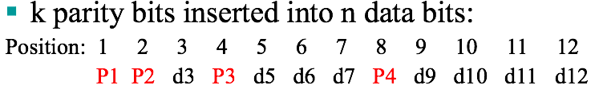
Determine the position of parity bit
Pi = 2^{i-1}
  Where i is the i^{th} bit position
For example:
Chapter 1 <number>

Slide 53
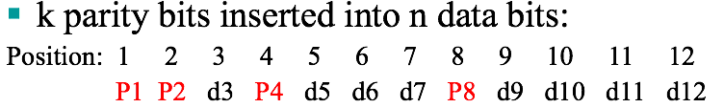
Determine the parity code
Starting from current position (i^{th} position), take number of i bits as the parity code, then skip number of i bits, and so on.
For example:
Chapter 1 <number>

Slide 54
Hamming Codes: Encoding
k parity bits inserted into n data bits:
Position: 1 2 3 4 5 6 7 8 9 10 11 12
P1 P2 d3 P3 d5 d6 d7 P4 d9 d10 d11 d12
d3, d5, d6, d7, d9, d10, d11, d12: original data bits
P4 = even parity for (d9, d10, d11, d12)
P3 = even parity for (d5, d6, d7, d12)
P2 = even parity for (d3, d6, d7, d10, d11)
P1 = even parity for (d3, d5, d7, d9, d11)
Encode 10011101?
Chapter 1 <number>

Slide 55
Hamming Codes: Decoding
What values do you obtain for the data received?
Is P4 = even parity for (d9, d10, d11, d12)?
Is P3 = even parity for (d5, d6, d7, d12)?
Is P2 = even parity for (d3, d6, d7, d10, d11)?
Is P1 = even parity for (d3, d5, d7, d9, d11)?
Say, d11 is in error. What does the receiver do?
Say, d5 and d6 are both in error. What then?
Chapter 1 <number>

Slide 56
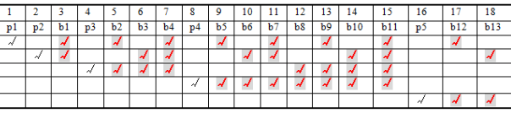
Parity Code Look up table
P1
P2
P3
P4
For example:
Original code: 111000111101, then
What if there is an error in P₃ even parity check?
What if there are errors in P₃ and P₄ even parity check?
Chapter 1 <number>

Slide 57
Hamming Codes: Distance = 3
2-bit errors can be detected
1-bit errors can be corrected
In general, if minimum distance = d:
    (d-1) bit errors can be detected
    ⎣(d-1)/2⎦ bit errors can be corrected
Chapter 1 <number>

Slide 58
Component 1:
Introduction and Overview
Digital Systems and Computer Systems
Number Systems [binary, decimal, octal and hexadecimal] and base conversion
Introduction to Coding Theory
Arithmetic Operations
Chapter 1 <number>

Slide 59
Binary Arithmetic
Single Bit Addition with Carry
Multiple Bit Addition
Single Bit Subtraction with Borrow
Multiple Bit Subtraction
Multiplication
BCD Addition
Chapter 1 <number>

Slide 60
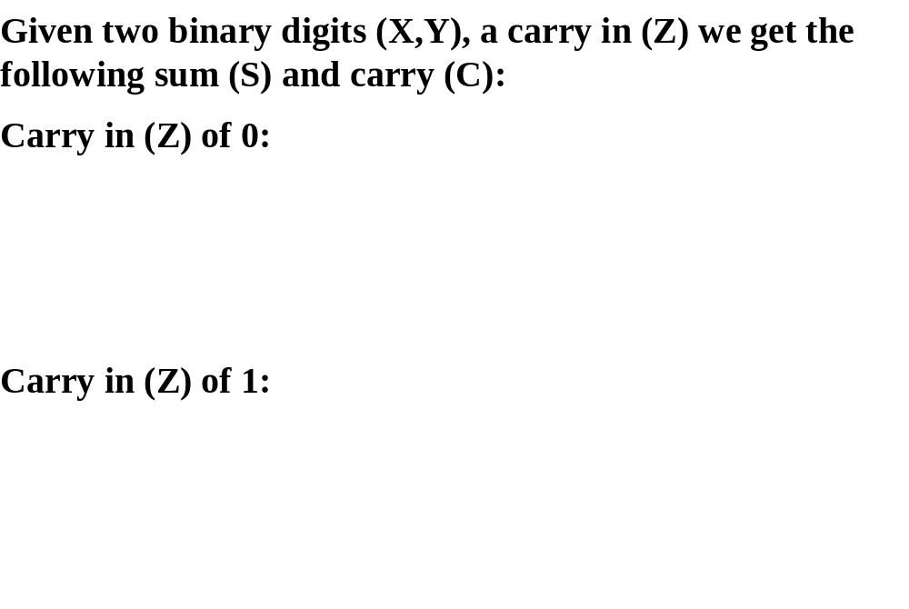
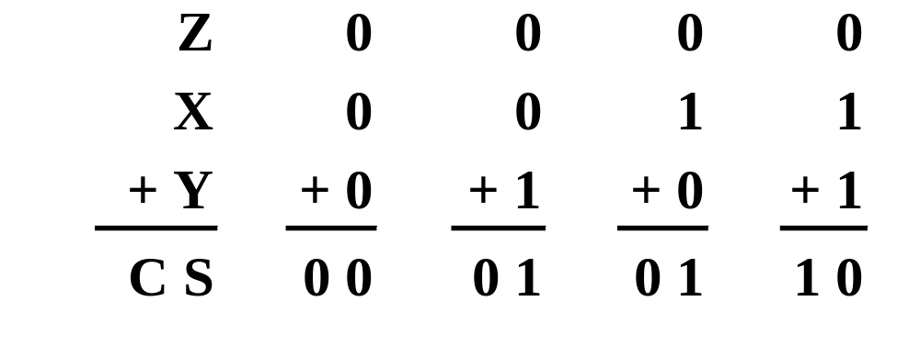
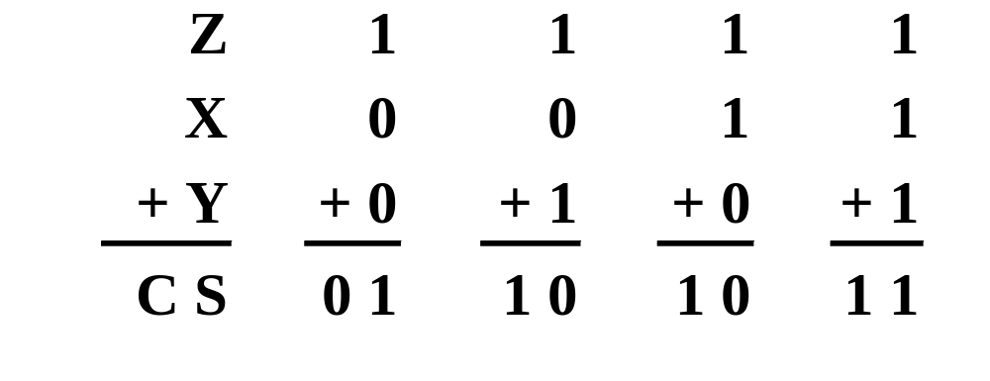
Single Bit Binary Addition with Carry
Chapter 1 <number>

Slide 61
Multiple Bit Binary Addition
Extending this to two multiple bit examples:
Carries 0 0
Augend 01100 10110
Addend +10001 +10111
Sum
Note: The 0 is the default Carry-In to the least significant bit.
Chapter 1 <number>
Notes:
Carries 00000 01100
Augend 01100 10110
Addend +10001 +10111
Sum 11101 101101

Slide 62
Single Bit Binary Subtraction with Borrow
Given two binary digits (X,Y), a borrow in (Z) we get the following difference (S) and borrow (B):
Borrow in (Z) of 0:
Borrow in (Z) of 1:
Z
0
0
0
0
X
0
0
1
1
- Y
-0
-1
-0
-1
BS
0 0
1 1
0 1
0 0
Z
1
1
1
1
X
0
0
1
1
- Y
-0
-1
-0
-1
BS
11
1 0
0 0
1 1
Chapter 1 <number>

Slide 63
Multiple Bit Binary Subtraction
Extending this to two multiple bit examples:
Borrows 0 0
Minuend 10110 10110
Subtrahend - 10010 - 10011
Difference
Notes: The 0 is a Borrow-In to the least significant bit. If the Subtrahend > the Minuend, interchange and append a – to the result.
Chapter 1 <number>
Notes:
Borrows 00000 00110
Minuend 10110 10110
Subtrahend –10010 –10011
Difference 00100 00011

Slide 64
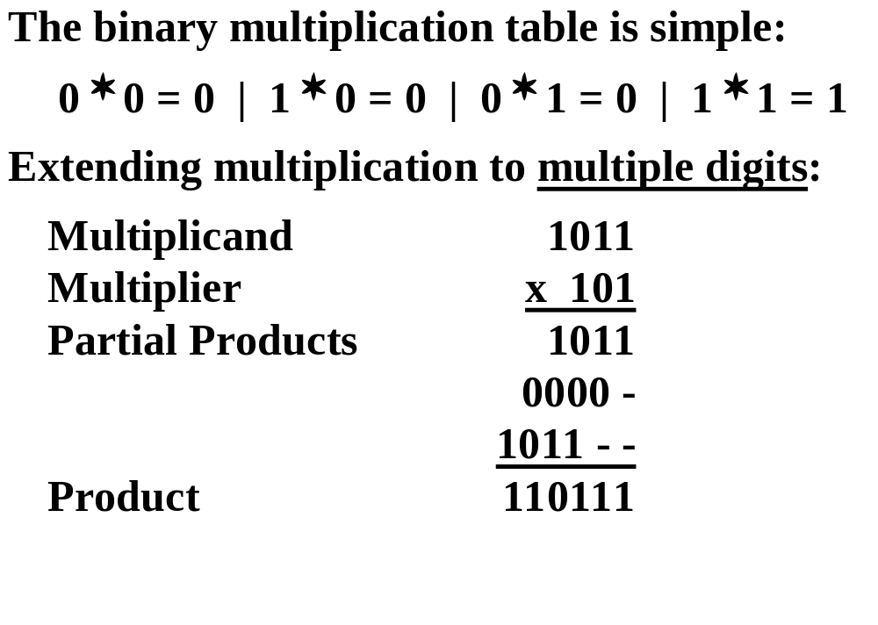
Binary Multiplication
Chapter 1 <number>

Slide 65
BCD Arithmetic
Given a BCD code, we use binary arithmetic to add the digits:
8
1000
Eight
+5
+0101
Plus 5
13
1101
is 13 (> 9)
Note that the result is MORE THAN 9, so must be
represented by two digits!
To correct the digit, subtract 10 by adding 6 modulo 16.
8
1000
Eight
+5
+0101
Plus 5
13
1101
is 13 (> 9)
+0110
so add 6
carry = 1
0011
leaving 3 + cy
0001 | 0011
Final answer (two digits)
If the digit sum is > 9, add one to the next significant digit
Chapter 1 <number>

Slide 66
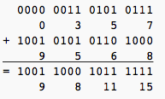
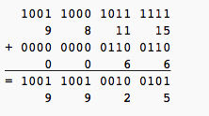
BCD Addition Example
Add 357_{BCD} to 9568_{BCD} showing carries and digit corrections.
Step 1
Step 2
Chapter 1 <number>
Notes:
1 1 1 0
0001 1000 1001 0111
+ 0010 1001 0000 0101
0100 10010 1010 1100
+ 0000+ 0110+ 0110+ 0110
0100 1000 0000 0010

Slide 67
Complements
Twos complements are used to store negative data in modern computers
To twos complement a number invert all the bits and then add 1 to the result
Chapter 1 <number>

Slide 68
Example – 8-bit unsigned
(10011001)₂ unsigned = 1*128 + 1*16 + 1*8 +1*1
= (153)₁₀
153
2
76
2
1
38
2
0
19
2
0
9
2
1
4
2
1
2
2
(10011001)₂
0
1
0
Chapter 1 <number>

Slide 69
Example – 8-bit signed in
2’s complement representation
(10011001)₂ signed = (-1)*128 + 1*16 + 1*8 +1*1
= (-103)₁₀
(01100111)₂ signed = (1)*64 + 1*32 + 1*4 + 1*2 +1*1
= (103)₁₀
From A to –A:
Negate all bits
Add 1
01100111 → 10011000 → 100011001
(103)₁₀
(-103)₁₀
Chapter 1 <number>

Slide 70
Range
8-bit unsigned
(00000000)₂ to (11111111)₂
(0)₁₀ to (255)₁₀
8-bit signed (two’s complement)
(10000000)₂ to (01111111)₂
(-128)₁₀ to (127)₁₀
Chapter 1 <number>

